Slide 1
Movies Rating Prediction Analysis
Zimu Su/ Metis Business project

Slide 2



Nonnegligible impact of movie user score
woven into the ticket-buying behavior.
affect box-office performance.
influence the decision to make a movie.
important in recommendation system
….
Notes:
The impact of movie score to film industry cannot be ignored nowadays. Most of audiences always try to search a movie score or reviews before they decide to buy a ticket or not. So to some extent, the movie score can be considered as indicator of the popularity and box office performance.

Slide 3



Movie Production Features
Genres, Release date, Title, Budget, Cast, Director…
predict
Overview of
Data-driven Rating model
Movie score
Expectation of popularity, box office performance …
Notes:
A data-driven model based on movie score analysis can be served to guide the movie producers. Given a combinations of resources like Genres, Release date, Title, Budget, Cast, Director, the model can make prediction about the movie rating score, and the producer can in turn know the expectation of popularity or box office performance beforehand.

Slide 4
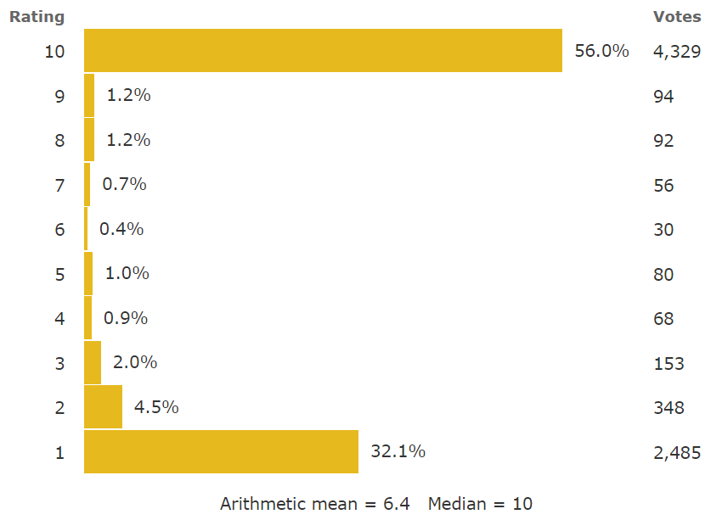
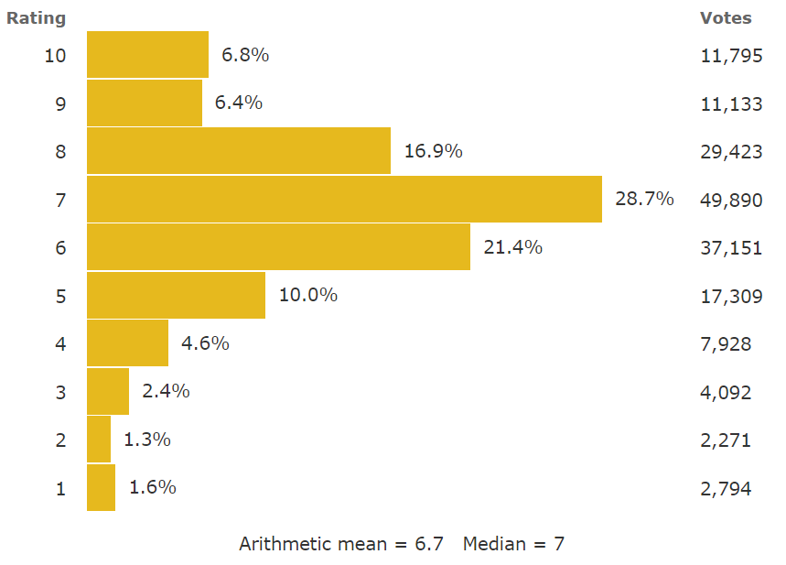
Underlying Problem: Score metrics based on single measure (like average) removes distribution information.
Different rating distributions can have the same average score.
Distribution-based score analysis provide elaborate information about audience’s feedback.
Concentrated good/bad
Evenly good/bad rating
Polarized
Notes:
One underlying problem of score measuring for a certain movie is the utilization of single measure like average, median, etc, which will remove the distribution information. Different rating distribution, like two score rating on the right, can have approximately the same average score, although the left movie has severe polarization pattern.
A distribution-based analysis can incorporate the comparison between the portions of rating number for different scores and more accurately reflect audience’s feedback for a certain type of movie.

Slide 5
Solution path
Identify rating distribution
Identify relationship between movies features and distribution pattern.
Use probability distribution function to characterize the shape.
Regression analysis between features and distribution shape.
Notes:
Then the distribution characteristics can be quantitively evaluated using probability distribution function.

Slide 6
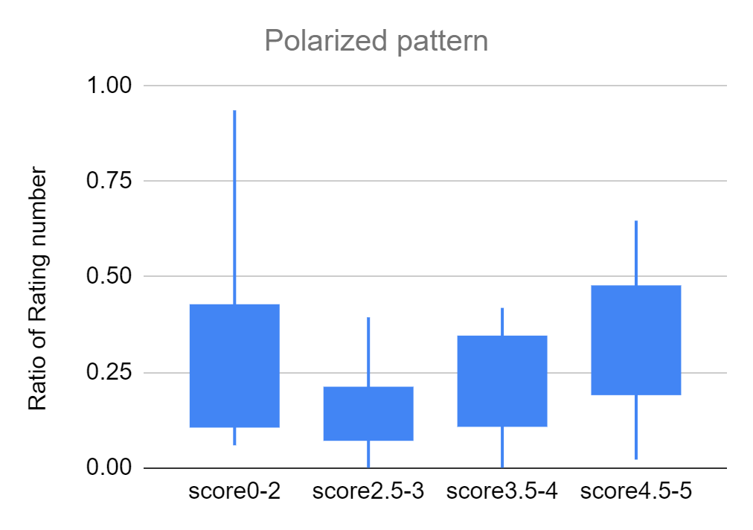
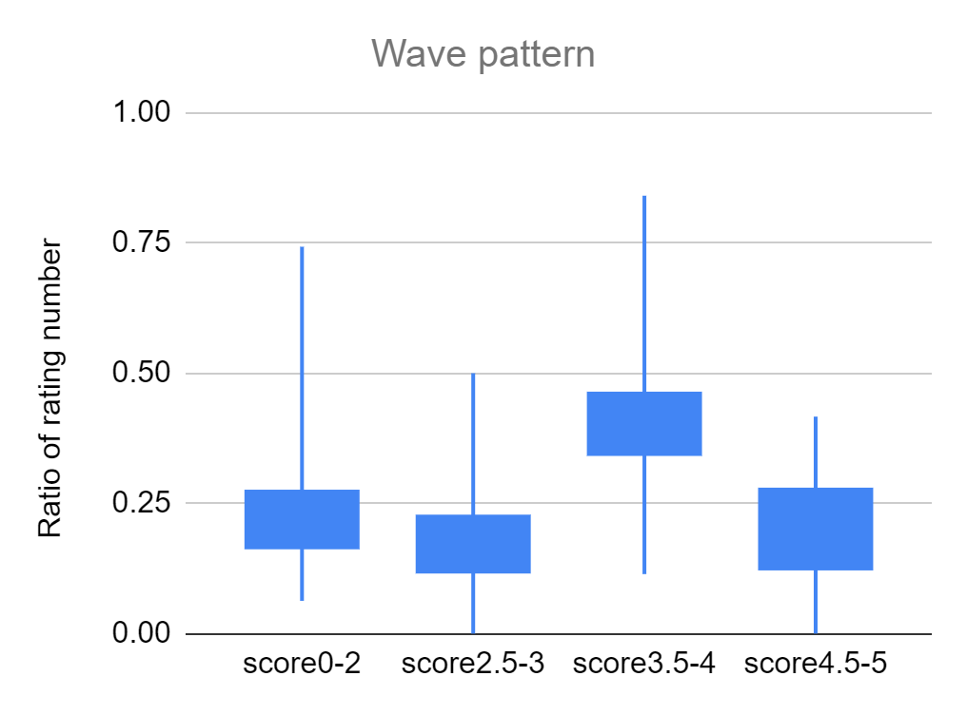
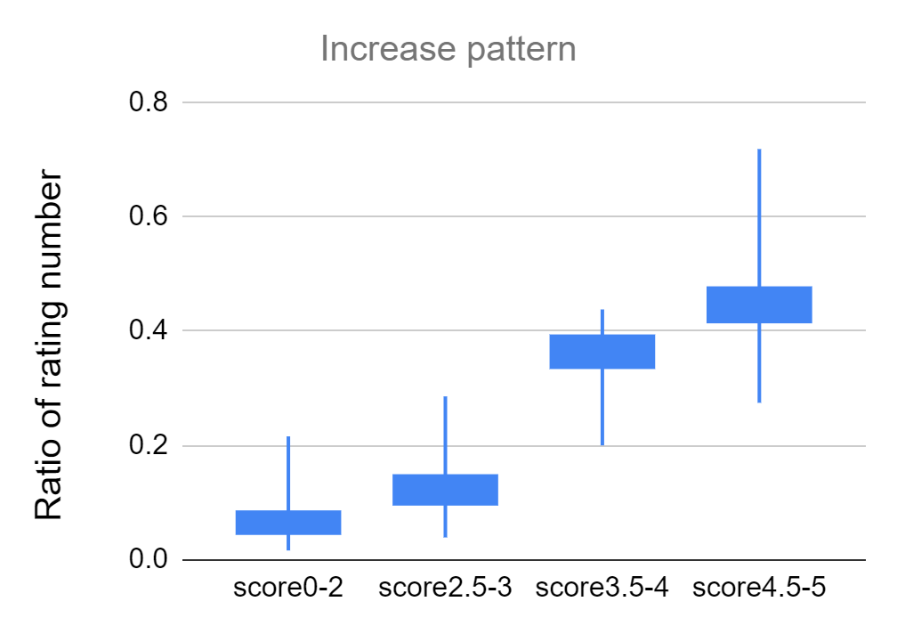
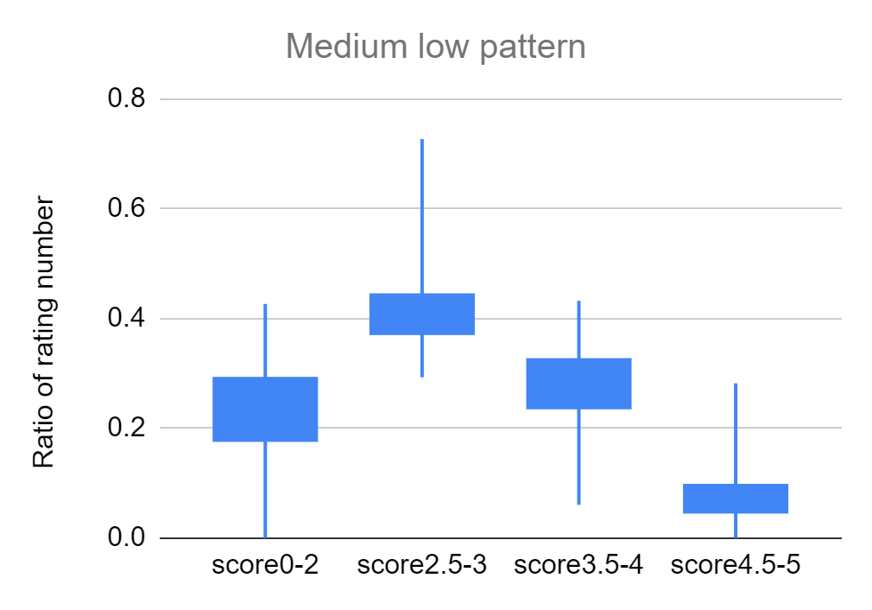
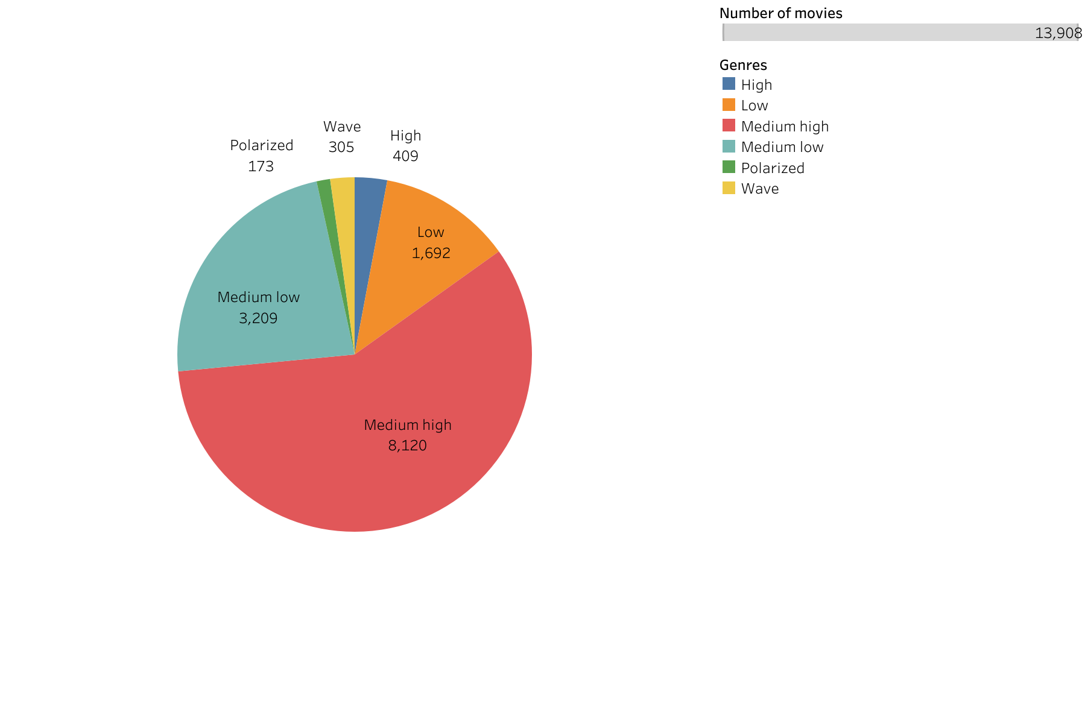
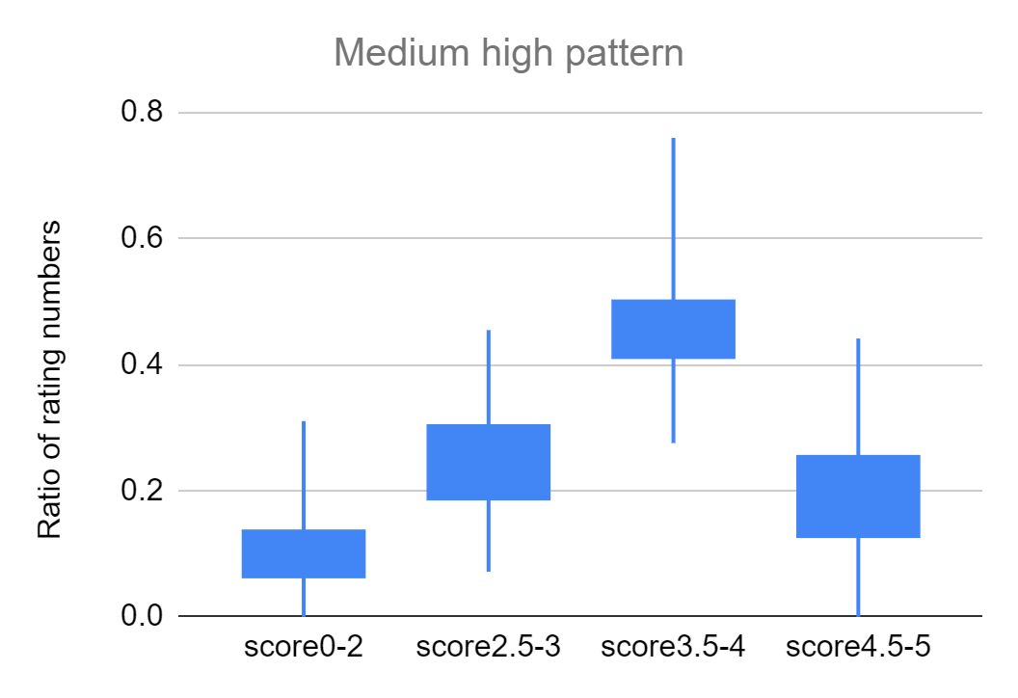
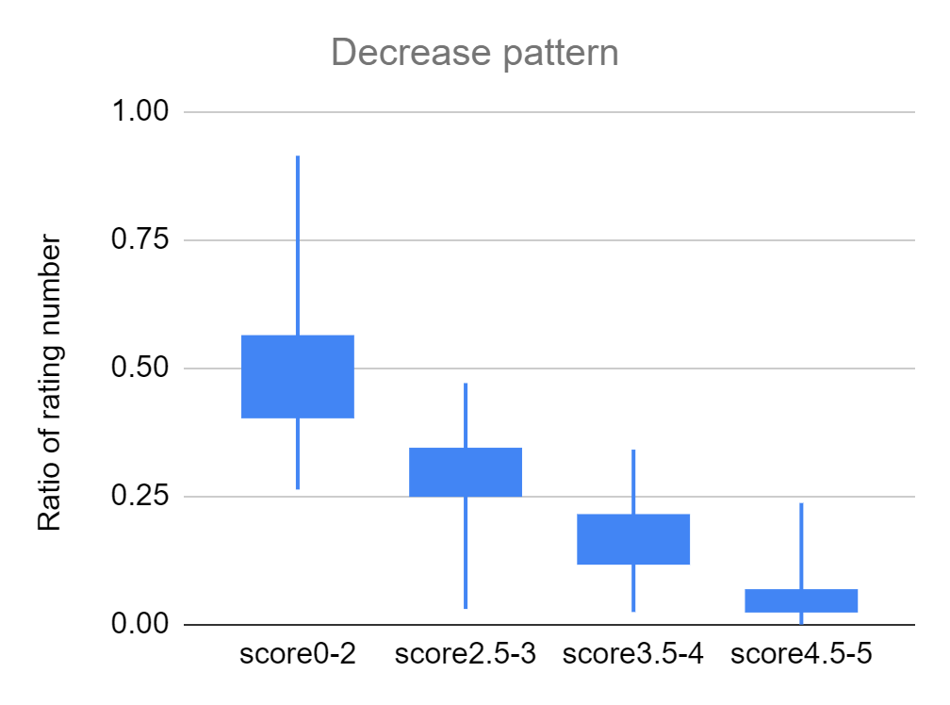
Distribution analysis
Controversial
Polarized
Wave rating
>40,000 movies info collected from Grouplens website
High
Medium low
Filtered with total ratings > 40
Medium high
~14,000movies left
Low
Notes:
The movie dataset is from Grouplens, which is a research institute and it collects more than 40,000 movies information. But most of them have very few ratings so I select the movies with more than 40 ratings and 14,000 movies is left. Those movies are categorized into several groups based on the comparison of the rating number within the score intervals. In those distribution categories, the largest rating number locate in different score intervals but obviously most audience have consensus on their feedback. Those movies appropriate a very large portion.
For the rest of movies which can be considered as controversial, because most of the audience have different opinions on the movies.

Slide 7
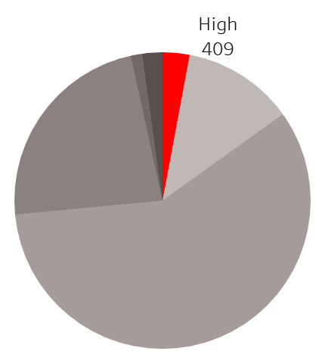
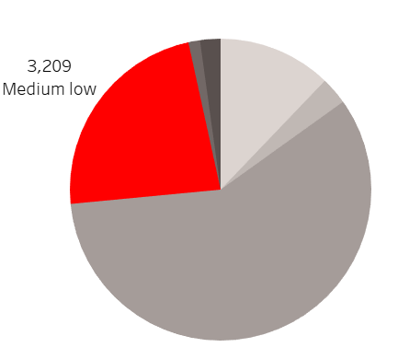
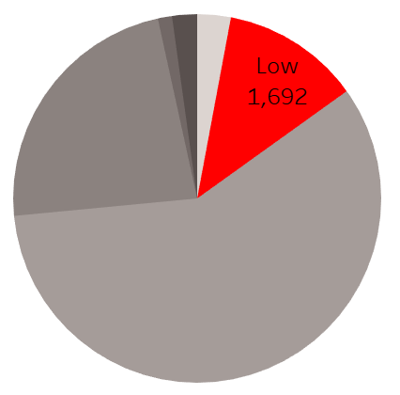
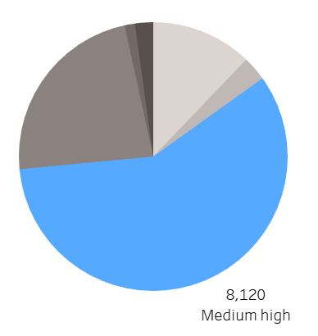
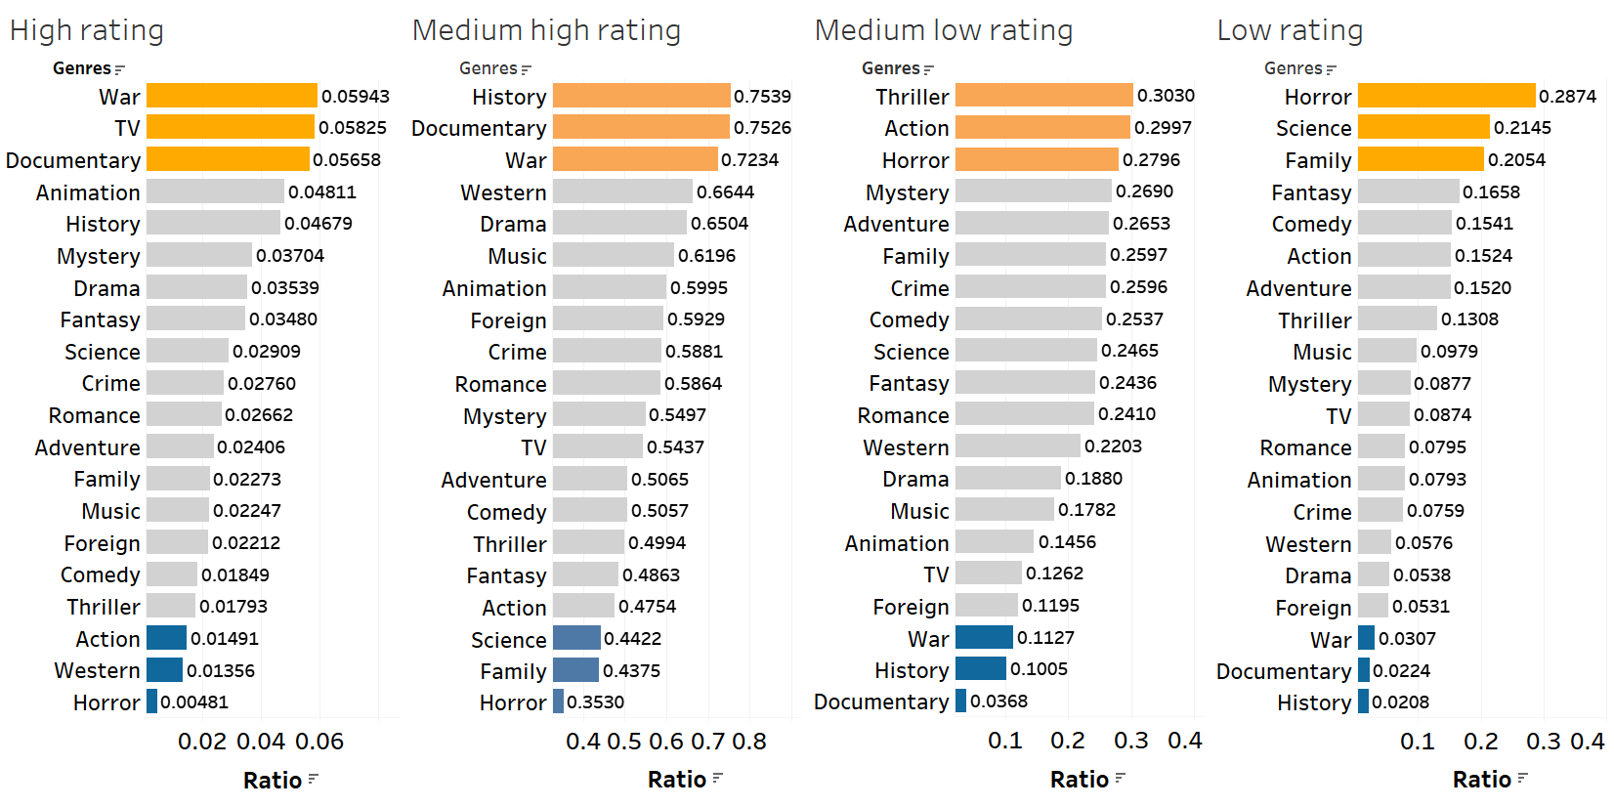
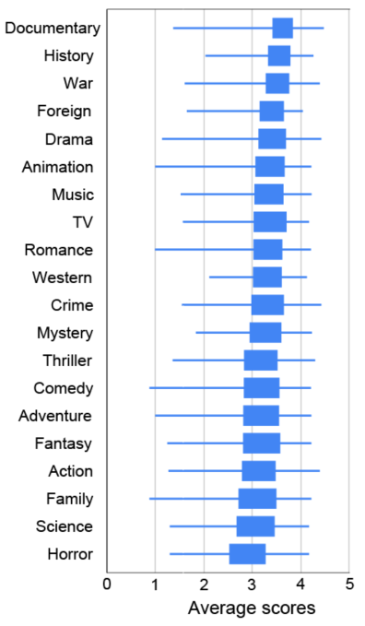
Genre analysis
Notes:
Let’s look at the composition of the movies in those distributions. Each bar stands for the portion of the movies in the category. For example, nearly 6% war film is within the category of high rating pattern. 75% history movies is within the category of medium high rating pattern. The box plot of the average scores for each genre is also listed for comparison.

Slide 8
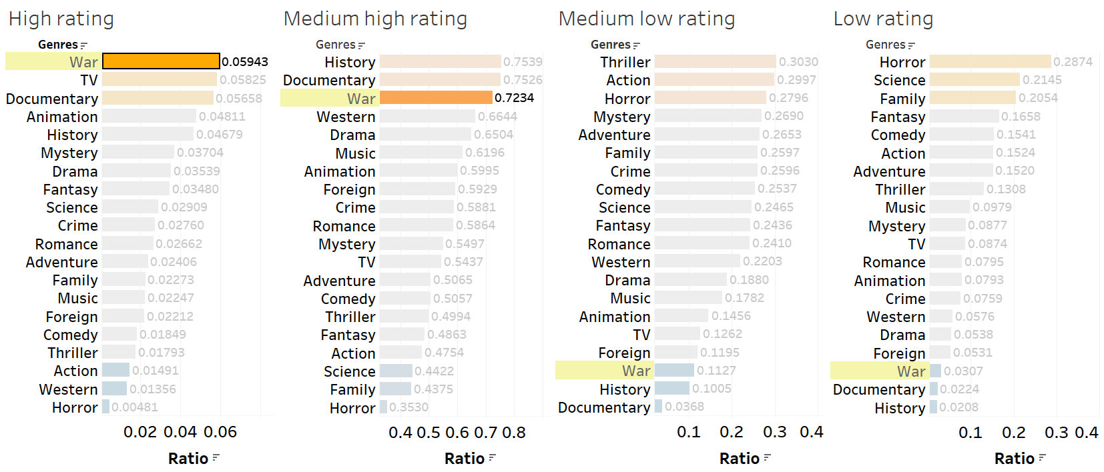
Consistent good rating
Other examples: Documentary, animation, history
Notes:
We can further probe into the genre composition. For example, the war movie have more portion in the distribution pattern of high rating and medium high ratings compared to most other genres, but less portion in medium low and low pattern. This is consistent with average score analysis. Then it can tell that the genres like war, Documentary, animation, history can have higher probability to get higher scores.

Slide 9
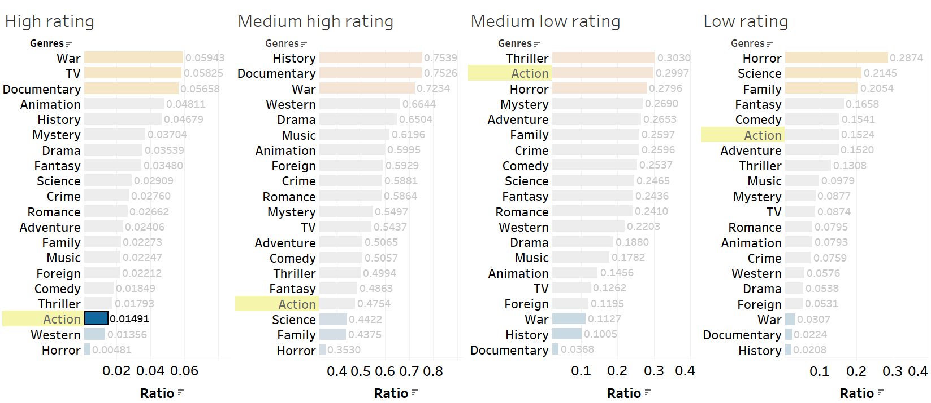
Consistent bad rating
Other examples: Horror, Thrill
Notes:
Contrary examples can be action, horror, thrill movie which have small amount in distribution pattern of high rating and large portion in low rating pattern. Producing those movies have lower probability to get good scores.

Slide 10
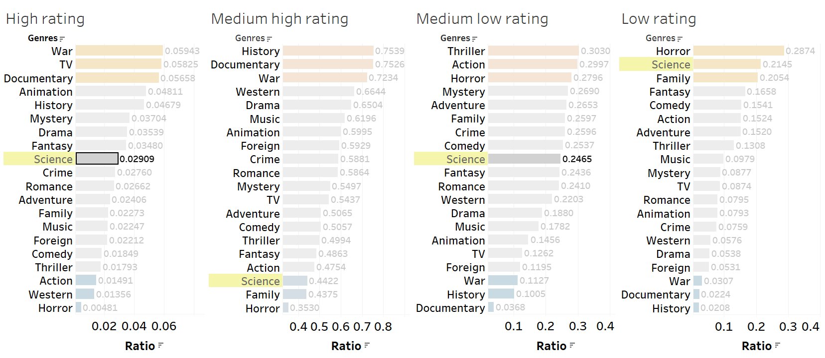
Some are excellent but most of them are bad
Other examples: Fantasy, Mystery, Adventure
Notes:
Some genres are kind of different. For instance, science movies have relatively large portion in the high rating pattern compared to other genres. But most of science movies have low or medium low rating pattern, so the average score is not very high. But we cannot ignore there are still numbers of science movies having great score.

Slide 11
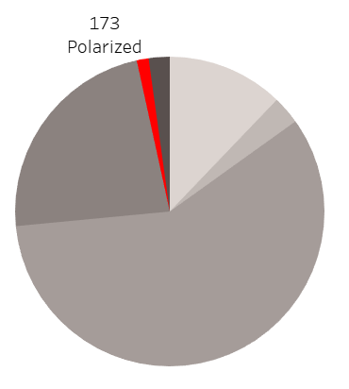
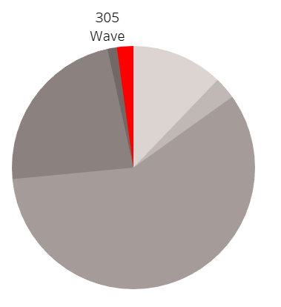
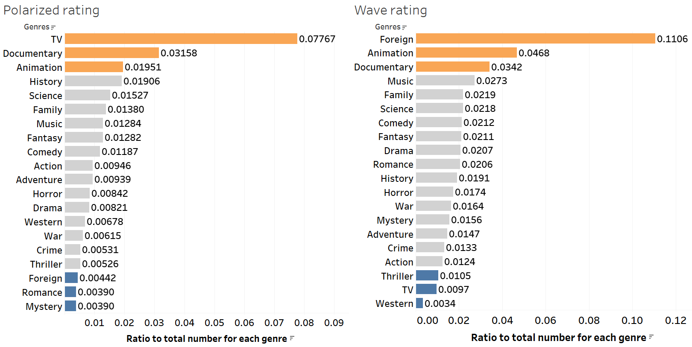
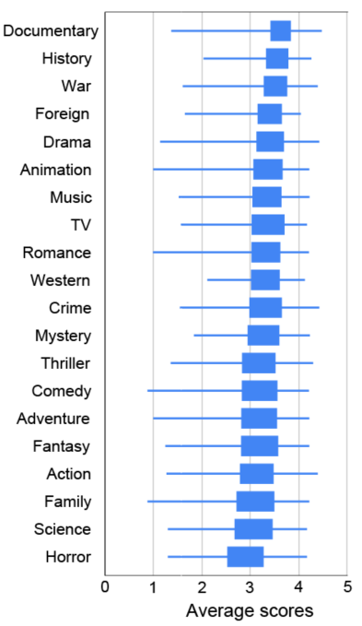
Genre analysis of controversial movies
Notes:
Let’s turn to controversial movies. The TV, documentary, foreign, animation have more portions in controversial categories compared to other genres, especially for TV and foreign movies. Their risk of becoming controversial is lot more than others.

Slide 12
Next step:
Incorporate more features such as title, budget, cast, director, etc.
Parameterize the distribution shape.
Build regression model between features and distribution parameters.

Slide 13
Thank you

